Slide 1
SAPPIN’ The
Enterprise
Breaking What No One Else Pentests
Speaker
BSides London
Jonathan Pake
2025

Slide 2
What is SAP?

Slide 3
SAP Modules (Flower Shop)
HR
Accounting
Manufacturing
Distribution
Section about the different SAP modules (HR, benefits, accounting, manufacturing, distribution etc… with the analogy of a small flower shop

Slide 4
Architecture diagram of SAP (S4/HANA, ERP, Fiori, etc…)
SAP Architecture

Slide 5
Why do we care about SAP?
List some real-world attacks and examples of SAP compromise
List some high/critical SAP vulnerabilities (e.g. SAP Netweaver RCE from March 2025)
* List statistics about number of vulnerable SAP instances

Slide 6
Real-World Example
Jaguar Land Rover (September 2025)
Stoli Bankruptcy (January 2025)
Disturbing trend of high-profile SAP attacks on the rise

Slide 7

SAP Attacks

Slide 8
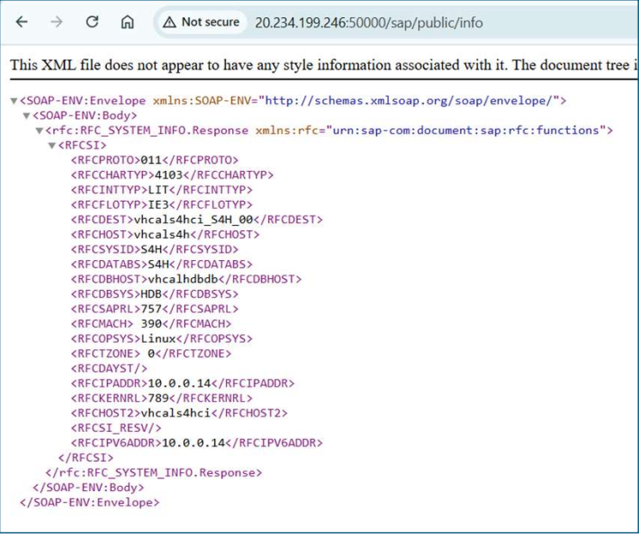
ICM/ICF – 80, 443, 8XXX, 5NN00 ports.
SICF Tcode
http:/SAP:50000/sap/public/info
SAP ICM/ICF Pages

Slide 9



SAP Password Storage
Location
History
Compatibility
Password hashes primarily stored under USR02
Historical values in USH02, USH02_ARC_TMP, USERPWDHISTORY.
Multiple hash versions can coexist for compatibility.

Slide 10
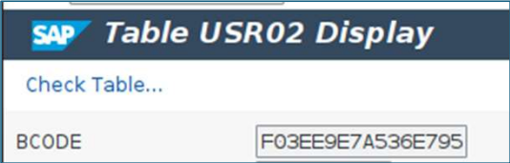
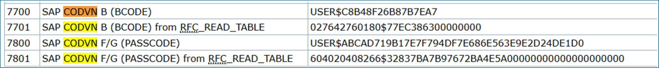
Hash Formats
CODVN B/D: MD5-based (8-char limit)
CODVN F: SHA-1 with fixed salt (40 UTF 8-chars)
CODVN H: SHA-1 with random salt (40 UTF 8-chars)
CODVN G/I: Generate multiple hashes (B+F or H+F+B)

Slide 11
Dummy text
RFC Callback Attacks
Dummy Text (LIVE DEMO?)

Slide 12
Dummy
SAP_DEV Attack
Dummy

Slide 13
Dummy
SAP Recon
(CVE-2020-6286)
Dummy

Slide 14
What is SSFS??
How can we attack it?
SSFS Attacks
Dummy

Slide 15
Attacks on business-critical apps like SAP have risen ~210% from 2024→2025.
These systems underpin finance, supply-chain, HR, customer ops, so compromise hits everything.
Threat actors (state-affiliated + cyber-crime) are converging on SAP environments.
It’s not if, but when your SAP system is attacke.
Conclusion
Dummy

Slide 16
Thank You!
jonathan@rootsec.me
jonathan-james-pake

Slide 17
?
?
Any Questions?
Yes
No

Slide 18
Talking points:
Nmap scanning
Nmap SAP probes
Various ports
HA & MC disclosure
WSDL/SOAPUI
DIAG Explanation
SAP Dispatcher (DIAG) & Wireshark
SAP ICM/ICF Public Pages
Password Explanation
Password Cracking (HC/JtR)
Remote Function Call (RFC)
RFC Types (?)
RFC Connection Properties
RFC Callbacks (DEMO)
RSECTAB (IDENT/DATA Columns)
  IDENT (RFC Name)
  DATA (Passwords)
RFC Decryptor (Python DEMO)
Remote Logon Proxy Attacks
Superuser Roles
Critical T-CODES
SAP Developer Attacks
SM01_DEV/SM01_CUS
Developer Debug Bypass via Breakpoints
SAP CIMB Attacks
Development slide – remember to delete!

Slide 19
Talking points:
EXE Replacement (Bind Shell)
Bypass SAP ABAP Locks
Enqueue Server (EQ)
Message Server (MS) Disclosures
Fiori Vulnerabilities (?)
AS Java Vulnerabilities
SAP Java Hashes
Path Traversals
File Uploads
P4 Service Vulnerabilities
SAP RFC Destinations
Cloud Connector
  Password logs
  NTLM
  Exec CMD.exe
Forensics (?)
SSFS Decryption
Development slide – remember to delete!

